Slide 1
Statement
In order to supply areas in distress with basic supplies, a humanitarian convoy is formed as a train with n cars. The train will go through each area and unload supplies. The supplies are packed in m special containers (m>>n). The mass for each container is known (can be read from a text file). Use a genetic algorithm to find a way to distribute the containers into cars so that the mass is distributed as evenly as possible. There is no upper mass limit for cars.

Slide 2
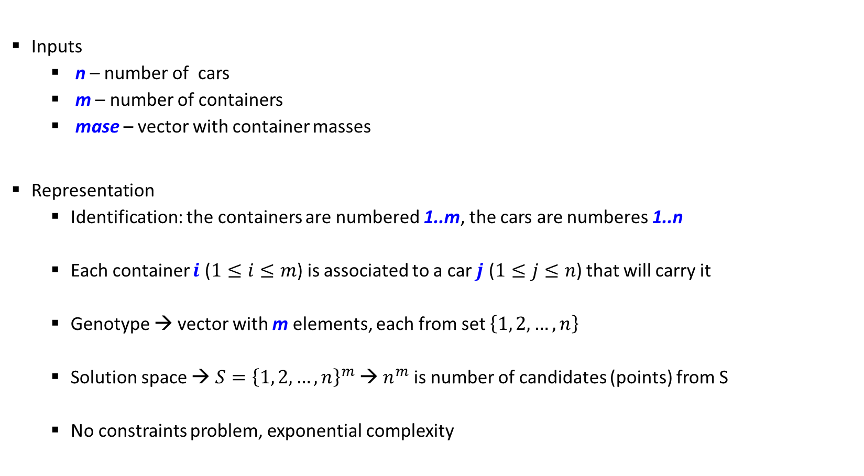
GA solution
Inputs
n – number of cars
m – number of containers
mase – vector with container masses
Representation
Identification: the containers are numbered 1..m, the cars are numberes 1..n
Each container $i$ ($1≤i≤m$) is associated to a car $j$ ($1≤j≤n$) that will carry it
Genotype → vector with m elements, each from set $\left\{1, 2,…,n\right\}$
Solution space → ${S=\left\{1, 2,…,n\right\}}^{m}$ → $n^{m}$ is number of candidates (points) from S
No constraints problem, exponential complexity

Slide 3
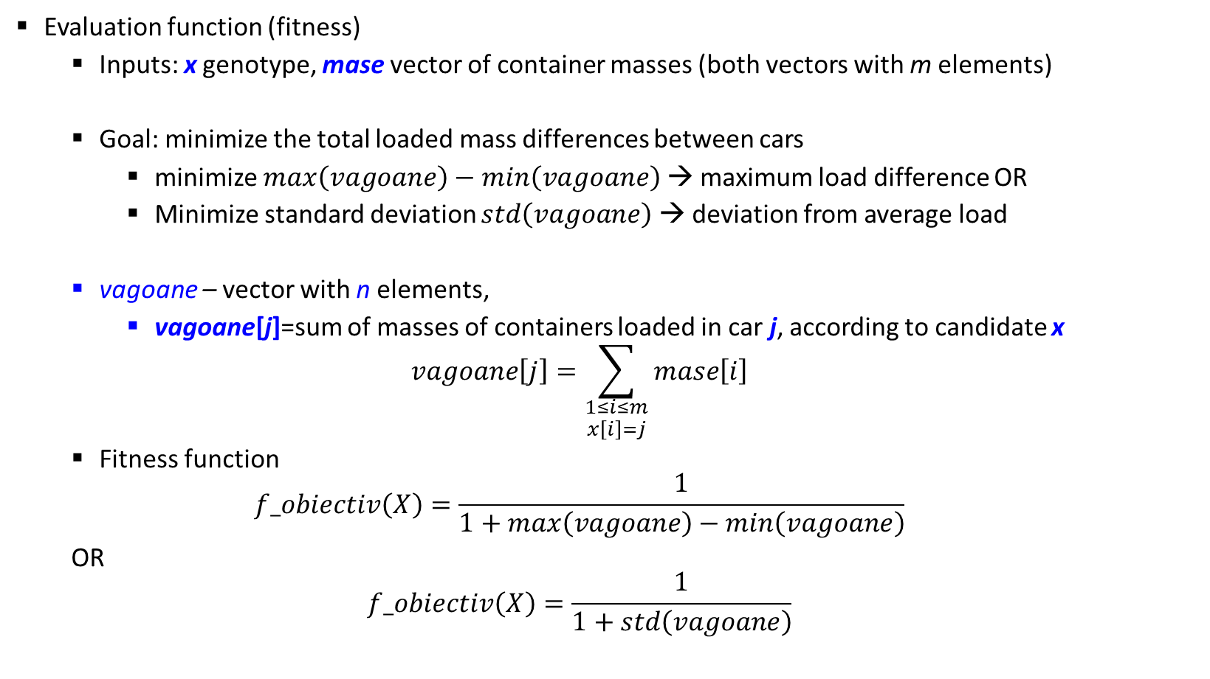
GA solution
Evaluation function (fitness)
Inputs: x genotype, mase vector of container masses (both vectors with m elements)
Goal: minimize the total loaded mass differences between cars
minimize $max\left(vagoane\right)−min\left(vagoane\right)$ → maximum load difference OR
Minimize standard deviation $std\left(vagoane\right)$ → deviation from average load
vagoane – vector with n elements,
vagoane[j]=sum of masses of containers loaded in car j, according to candidate x
$$vagoane\left[j\right]=\sum_{\begin{aligned}1≤i≤m \\ x\left[i\right]=j\end{aligned}}{mase\left[i\right]}$$
Fitness function
$$f_obiectiv\left(X\right)=\frac{1}{1+max\left(vagoane\right)−min\left(vagoane\right)}$$
OR
$$f_obiectiv\left(X\right)=\frac{1}{1+std\left(vagoane\right)}$$

Slide 4
GA solution
Population model
generational (NP-complete problem, easy to evaluate fitness)
constant size population, dim
initial population generation
Random, uniformly distributed in solution space
Parent selection
Generational model → from dim candidates in current population select dim parents
The fitness function has positive values → SUS mechanism with FPS with sigma scaling
Selection of next generation
Elitism

Slide 5
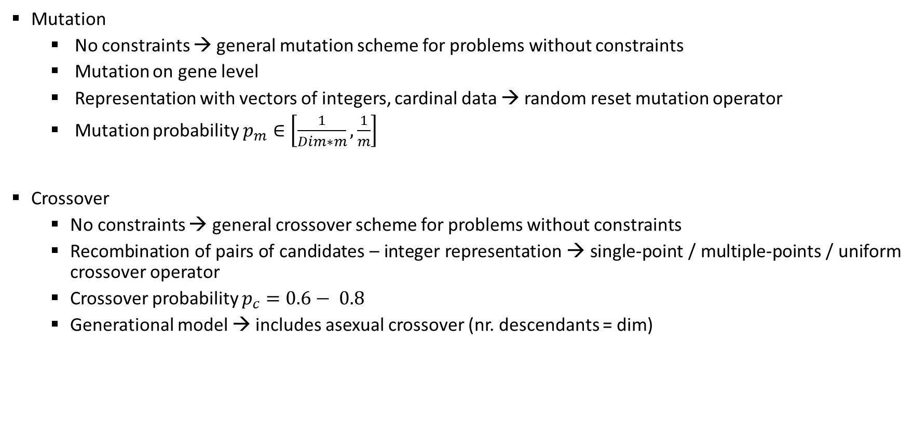
GA solution
Mutation
No constraints → general mutation scheme for problems without constraints
Mutation on gene level
Representation with vectors of integers, cardinal data → random reset mutation operator
Mutation probability $p_{m}∈\left[\frac{1}{Dim∗m},\frac{1}{m}\right]$
Crossover
No constraints → general crossover scheme for problems without constraints
Recombination of pairs of candidates – integer representation → single-point / multiple-points / uniform crossover operator
Crossover probability $p_{c}=0.6− 0.8$
Generational model → includes asexual crossover (nr. descendants = dim)

Slide 6
GA solution
Stop condition
Limited number of generations is reached
All current candidates have the same fitness
During the last k generations the maximum fitness did not increase
Computed result → best individual from the final population

